Slide 1
User Input and While Loops
Notes:
List of operators: https://www.w3schools.com/python/python_operators.asp
While Loops: https://www.w3schools.com/python/python_while_loops.asp

Slide 2
Learning Objectives
To understand the purpose of while loops and when it can be helpful
To understand the use case of the input() function
To be able to use continue, break, and flags within a while loop

Slide 3
Quick Recap before we begin….

Slide 4
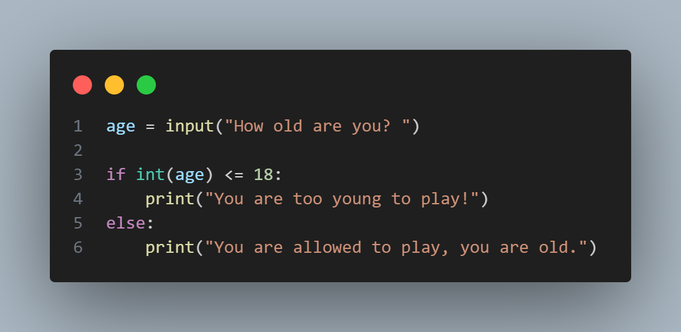
Make sure you remember: Python interprets everything the user inputs as a string!
int() function = tells Python to treat the input as a numerical value, not as a string.
Notes:
age = input("How old are you? ")
if int(age) <= 18:
print("You are too young to play!")
else:
print("You are allowed to play, you are old.")
#Another Example
prompt = "Thank you for your interest in this event! "
prompt += "Before we process your payment: "
age = input("How old are you? ")
age = int(age)
if age <= 17:
print("You are too young to attend this event. Sorry!")
elif age <= 99:
print("You may attend this event! We will process your payment.")
else:
print("You go random person! Have an awesome time.")

Slide 5
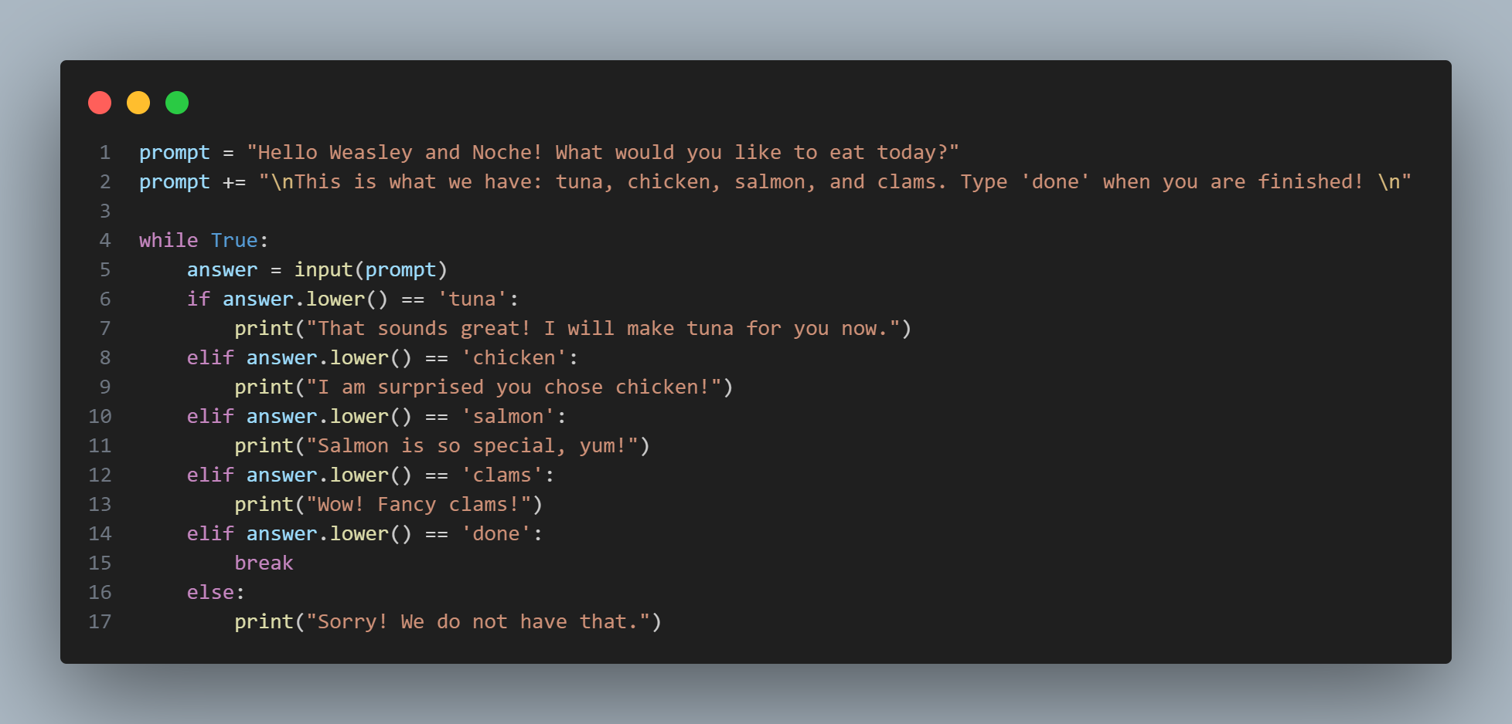
Notes:
prompt = "Hello Weasley and Noche! What would you like to eat today?"
prompt += "\nThis is what we have: tuna, chicken, salmon, and clams. Type 'done' when you are finished! \n"
while True:
answer = input(prompt)
if answer.lower() == 'tuna':
print("That sounds great! I will make tuna for you now.")
elif answer.lower() == 'chicken':
print("I am surprised you chose chicken!")
elif answer.lower() == 'salmon':
print("Salmon is so special, yum!")
elif answer.lower() == 'clams':
print("Wow! Fancy clams!")
elif answer.lower() == 'done':
break
else:
print("Sorry! We do not have that.")

Slide 6
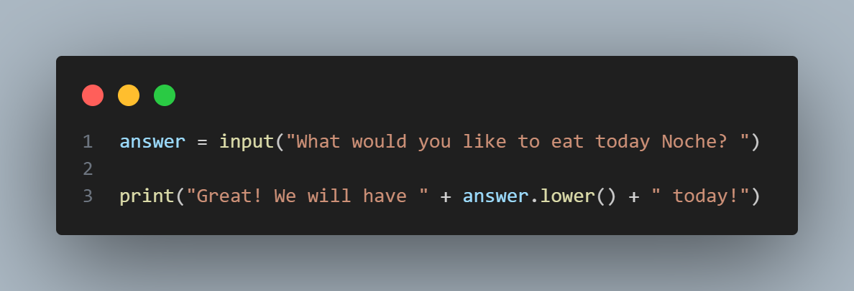
input() Function
The input() function pauses your program and waits for the user to enter some text. Once Python receives the user’s input, it stores it in a variable to make it convenient for you to work with.
Make sure you are very clear on what you want the user to answer.
Notes:
answer = input("What would you like to eat today Noche? ")
print("Great! We will have " + answer.lower() + " today!")
#Multi line strings example
prompt = "Today we are going to learn about user input and while loops..."
prompt += "Are you excited? "
answer = input(prompt)
print(f"You answered: {answer}!")
#Multi line strings example
prompt = "Today we are going to learn about user input and while loops..."
prompt += "Are you excited? "
'''
Did
you
also
know
you
can
use
doc-strings
to
have
multi line
comments?
'''
answer = input(prompt)
print(f"You answered: {answer}!")

Slide 7
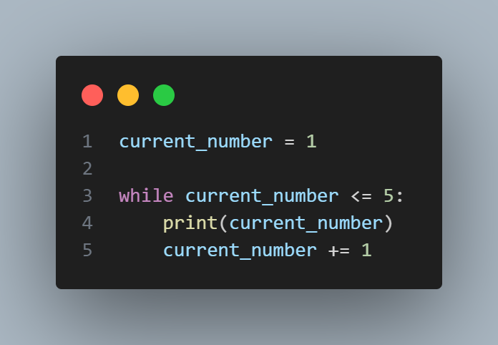
While Loops
The while loop runs as long as, or while, a certain condition is true.
Notes:
current_number = 1
while current_number <= 5:
print(current_number)
current_number += 1

Slide 8
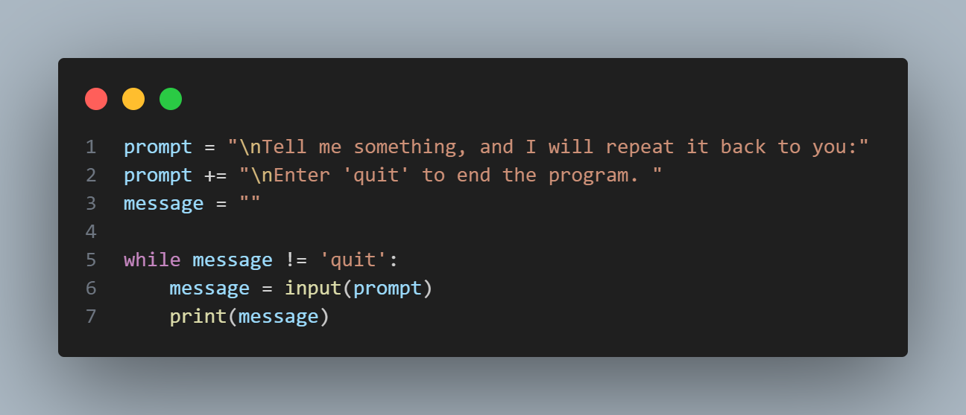
Letting a User Choose When to Quit
To allow a user to quit, you will need to assign a quit value.
Notes:
prompt = "\nTell me something, and I will repeat it back to you:"
prompt += "\nEnter 'quit' to end the program. "
message = ""
while message != 'quit':
message = input(prompt)
print(message)

Slide 9
Flags
For a program that should run only as long as many conditions are true, you can define one variable that determines whether or not the entire program is active. This variable, called a flag, acts as a signal to the program.
For example….

Slide 10
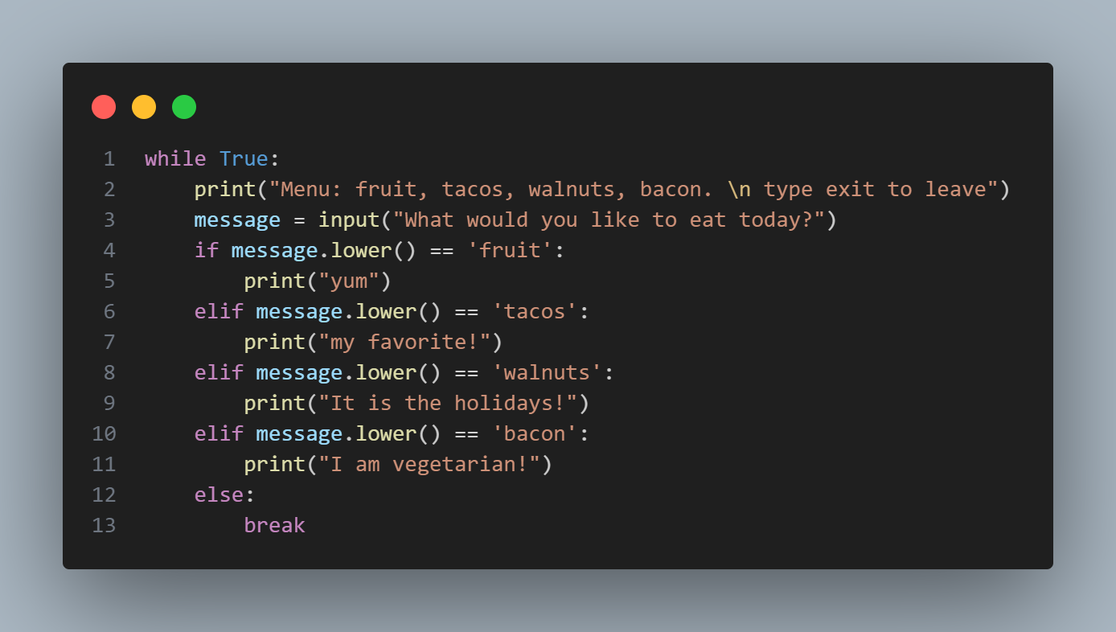
Break Statements
Notes:
while True:
print("Menu: fruit, tacos, walnuts, bacon. \n type exit to leave")
message = input("What would you like to eat today?")
if message.lower() == 'fruit':
print("yum")
elif message.lower() == 'tacos':
print("my favorite!")
elif message.lower() == 'walnuts':
print("It is the holidays!")
elif message.lower() == 'bacon':
print("I am vegetarian!")
else:
break

Slide 11
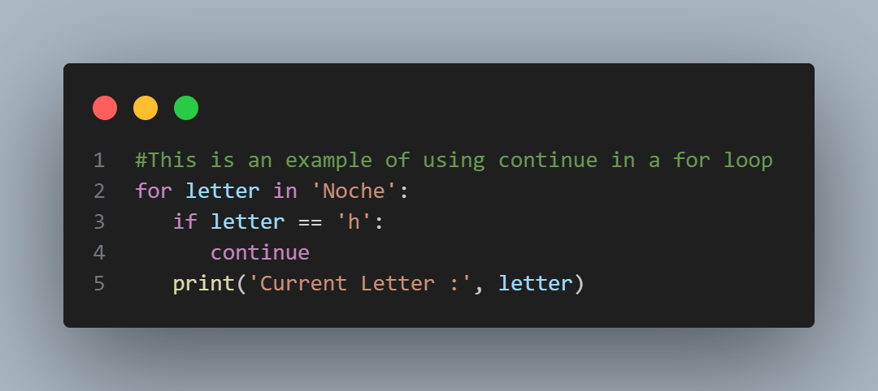
Using continue in a loop
Using continue is just a ‘skip’ over to the next option in the loop.
Notes:
#This is an example of using continue in a for loop
for letter in 'Noche':
if letter == 'h':
continue
print('Current Letter :', letter)

Slide 12
Make sure you add a break in your while loops! Otherwise you could be stuck in an INFINITE LOOP!
Notes:
I chose this because it RUNS forever…

Slide 13
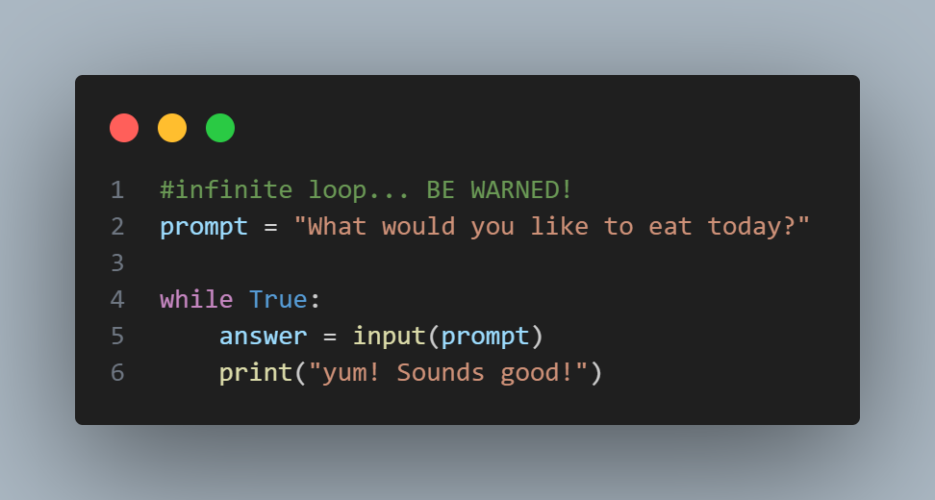
Infinite loop example… CAUTION!
Notes:
#infinite loop... BE WARNED!
prompt = "What would you like to eat today?"
while True:
answer = input(prompt)
print("yum! Sounds good!")

Slide 14
Notes:
prompt = "Hello Weasley and Noche! What would you like to eat today?"
prompt += "\nThis is what we have: tuna, chicken, salmon, and clams. Type 'done' when you are finished! \n"
while True:
answer = input(prompt)
if answer.lower() == 'tuna':
print("That sounds great! I will make tuna for you now.")
elif answer.lower() == 'chicken':
print("I am surprised you chose chicken!")
elif answer.lower() == 'salmon':
print("Salmon is so special, yum!")
elif answer.lower() == 'clams':
print("Wow! Fancy clams!")
elif answer.lower() == 'done':
break
else:
print("Sorry! We do not have that.")
As usual, can you modify my code? Or improve it? Share on Slack!

Slide 15
Well Done! Now, Onwards to exercise 7!

